Slide 1
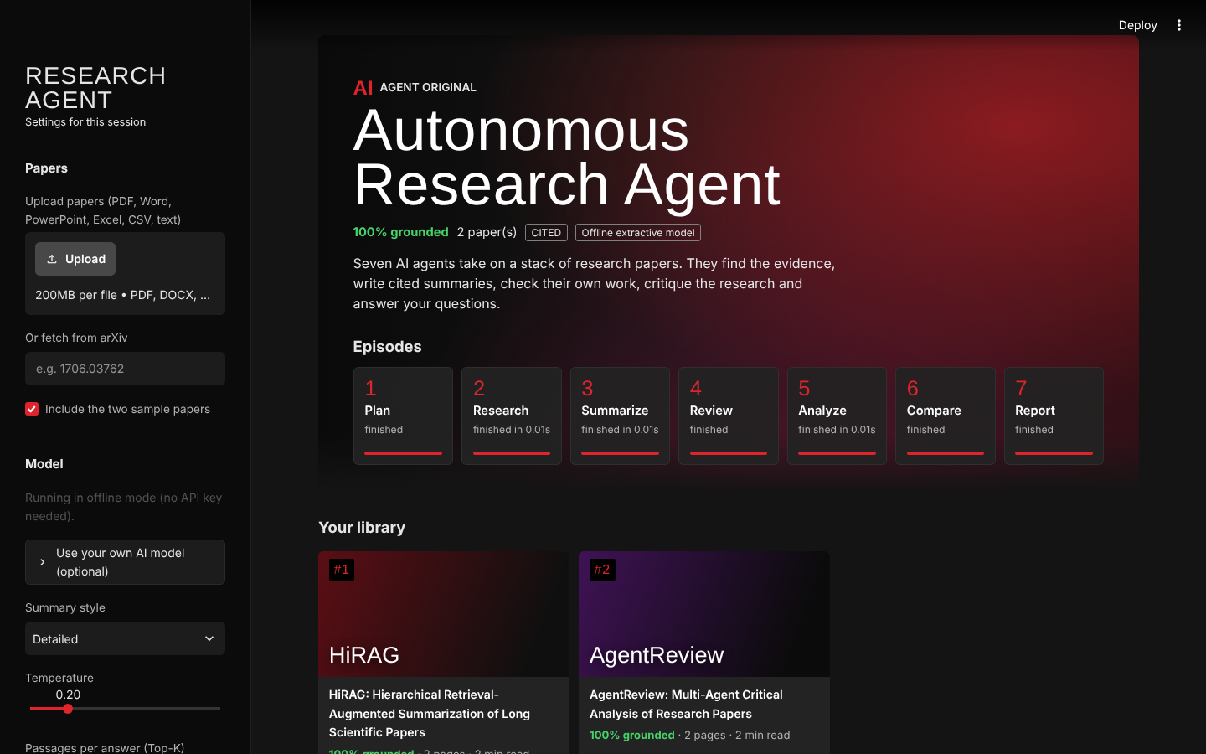
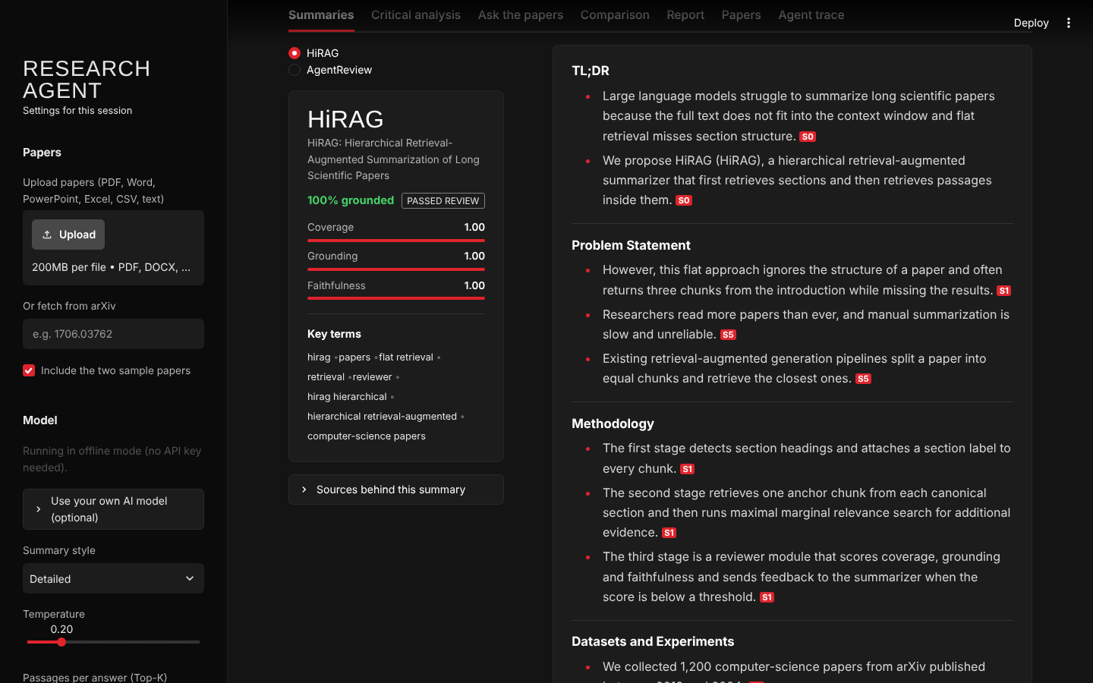
Autonomous AI Research Agent
FINAL AI CAPSTONE PROJECT
AI that summarizes research papers — with citations, self-review and chat
Akshay Kale · October 2026
Notes:
Good morning. My capstone project is an Autonomous AI Research Agent — an application that reads research papers and produces cited summaries, a critical analysis, a comparison between papers and a downloadable report, and lets you chat with the papers.
The two images on the right are real screenshots from the running application: the top one after all seven agents have finished, the bottom one is a cited summary.
In the next 15 minutes I'll cover the problem, the architecture, how the agents work, how I tested it, the results, and what I learned.

Slide 2



Paper summaries from LLMs can't be trusted blindly
Papers don't fit
Hallucinations cost trust
One prompt, every job
A full paper exceeds most context windows. Plain top-k retrieval returns three introduction chunks and misses the results and limitations.
One invented dataset or percentage makes a summary worse than none. Readers need to see where every claim came from.
Retrieval, summarizing, fact-checking and critique in a single prompt make errors impossible to trace or fix.
Goal An autonomous, auditable assistant that covers every part of a paper, cites every statement, checks its own output before showing it — and runs on a laptop without paid APIs.
Notes:
Three problems make naive LLM summarization unreliable.
First, length. A paper is longer than most context windows, so the model only sees part of it — and simple similarity search tends to return several near-duplicate chunks from the introduction, missing the results and limitations that matter most.
Second, hallucination. In research, an invented number is worse than no summary at all, because people quote it. So every claim must be traceable.
Third, doing everything in one prompt makes failures impossible to diagnose.
So my goal was an assistant that is complete, cited, self-checking, and that runs even without an API key.

Slide 3
Six objectives, each mapped to a component
01
Ingest any paper
PDF, Word, PowerPoint, Excel, CSV, text and arXiv IDs, with title, authors, abstract and sections extracted
02
Retrieve complete evidence
Section-aware chunking and retrieval so every part of the paper is represented
03
Summarize with citations
8 fixed sections; every bullet tagged with the passage it came from
04
Verify before showing
A Reviewer agent scores the summary and sends it back for revision
05
Go beyond summaries
Critical analysis, cross-paper comparison, research brief, cited chat
06
Run anywhere
OpenAI, Llama 3, Gemini — or fully offline with no API key
Notes:
I set six objectives, and each one maps directly to a part of the code.
Ingestion handles seven file types plus arXiv. Retrieval is section-aware so evidence covers the whole paper. The summarizer must cite every bullet. A Reviewer agent verifies the summary before the user sees it. The system goes beyond summarizing with critique, comparison, a report and chat. And it runs on four back-ends, including a completely offline mode.

Slide 4






Technology stack
Orchestration
LangGraph 1.2 StateGraph · LangChain 1.4 (LCEL: prompt | llm | parser)
Language models
OpenAI GPT · Llama 3 via Groq · Google Gemini · offline extractive model (TF-IDF)
Embeddings
sentence-transformers all-MiniLM-L6-v2 (384-d) · HashingVectorizer fallback
Vector store
FAISS (faiss-cpu 1.15) with MMR search and an on-disk cache
Documents
pypdf · python-docx · python-pptx · openpyxl · pandas
Interface & export
Streamlit 1.66 · ReportLab (PDF) · python-docx (DOCX) · Markdown
Python 3.13 · python-dotenv · SQLite LLM cache · rotating log file — all versions pinned in requirements.txt
Notes:
The core is LangChain for prompts and chains, and LangGraph for the multi-agent workflow — LangGraph because I need a loop, which a linear chain can't express.
For models, the app supports OpenAI, Llama 3 through Groq, and Gemini, plus my own offline extractive model. Every one is a LangChain chat model, so the agents never change when the provider does.
Embeddings are all-MiniLM-L6-v2 — small, fast on CPU — with an automatic fallback to hashing embeddings if the model can't download. FAISS is the vector store. Streamlit is the UI, and reports export to PDF, Word or Markdown.

Slide 5
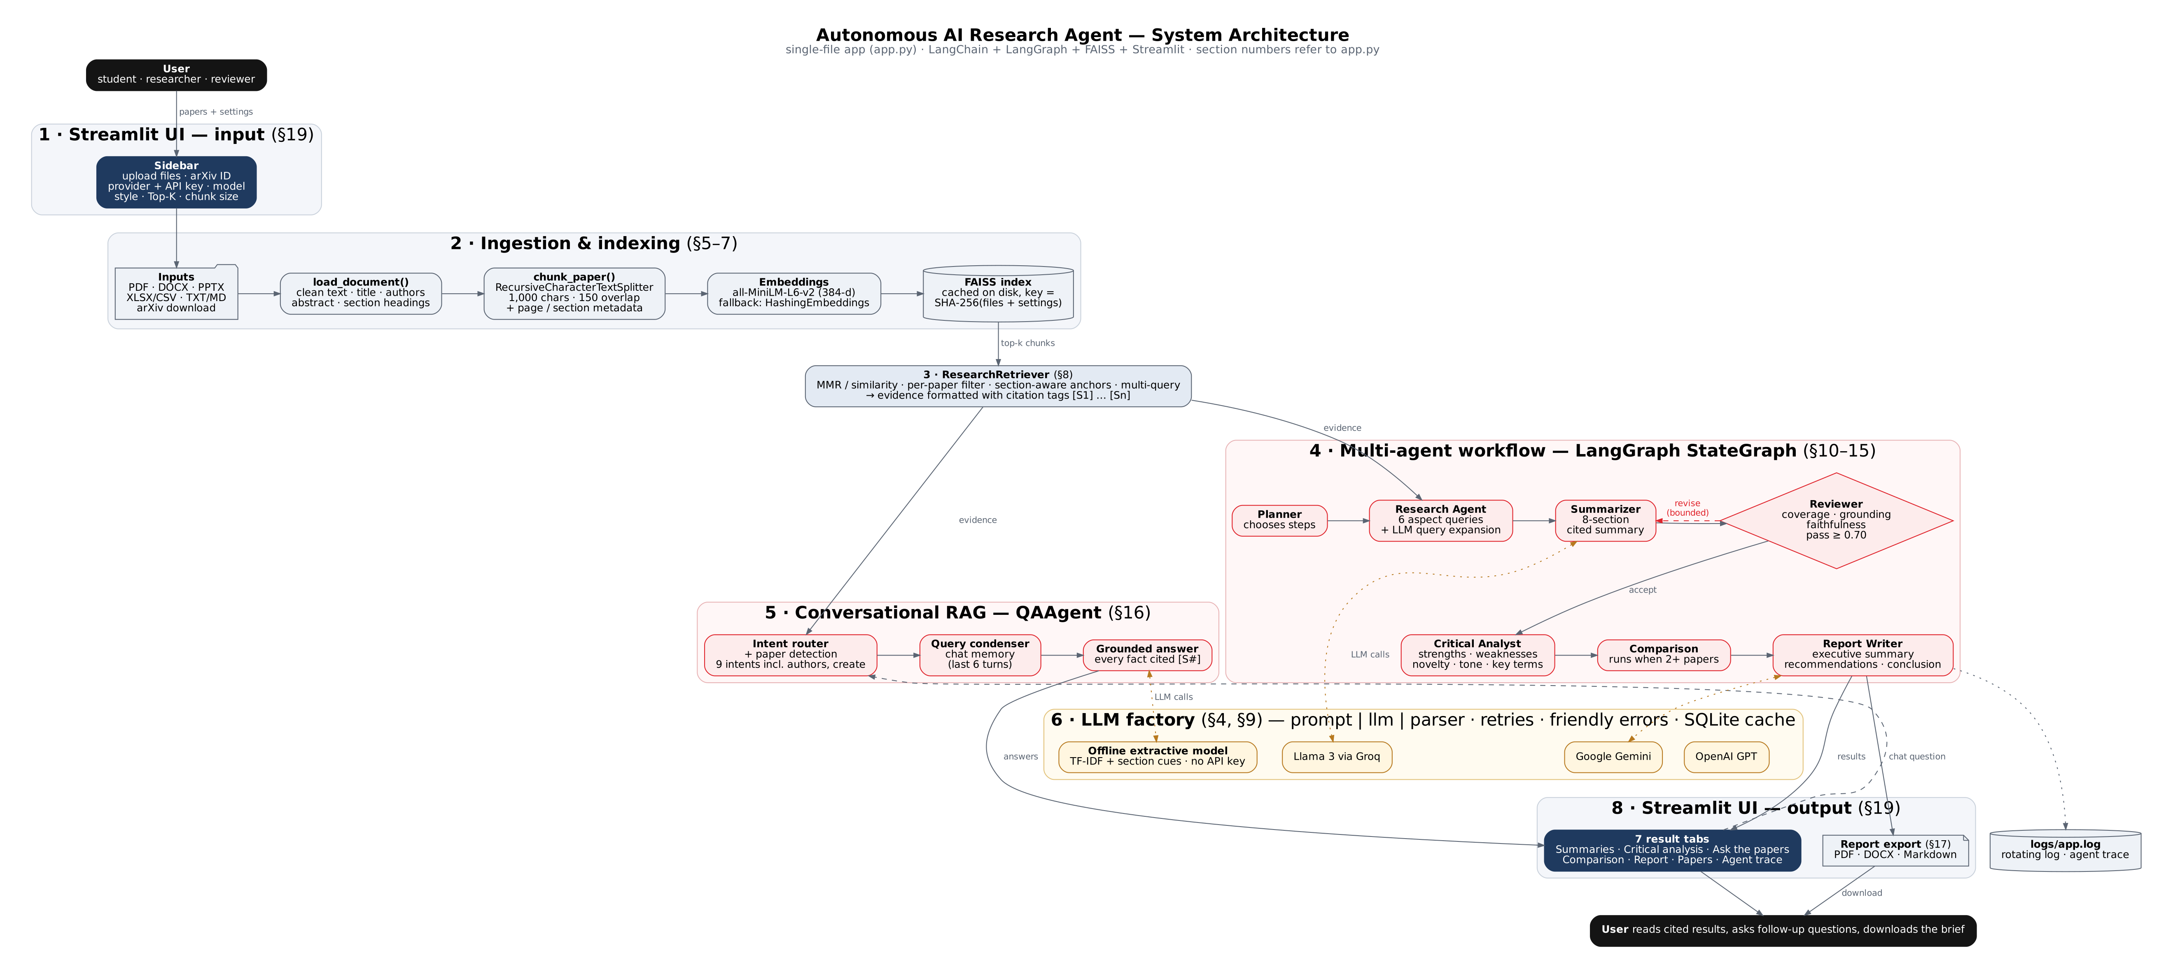
System architecture
Seven layers in one file (app.py, 19 sections): UI → ingestion & indexing → retrieval → agent workflow + conversational RAG → LLM factory → results & export
Notes:
Here is the full architecture. Read it top to bottom.
The user provides papers and settings in the Streamlit sidebar. Ingestion parses each file, chunks it with section metadata, embeds it and stores it in FAISS — cached on disk by a hash of the file contents and settings.
The retriever produces evidence where every chunk carries a citation tag, S1, S2 and so on. That evidence feeds two consumers: the multi-agent workflow on the right, and the conversational Q&A agent in the middle.
Both call language models through one LLM factory with retries, friendly errors and a response cache. Results go to seven tabs and to the PDF, Word and Markdown exporters.

Slide 6
Agent workflow: seven steps with a self-review loop
1
Plan
chooses the steps
2
Research
section anchors + 6 aspect queries (+ LLM query expansion)
3
Summarize
8 headings, every bullet cited
4
Review
coverage · grounding · faithfulness
5
Analyze
strengths, weaknesses, tone
6
Compare
only with 2+ papers
7
Report
brief + recommendations
revise with written feedback (bounded by MAX_REFLECTION_LOOPS)
Reviewer rule
score = 0.40 × coverage + 0.35 × grounding + 0.25 × faithfulness
Pass only if score ≥ 0.70 AND every number in the summary appears in the source evidence.
Notes:
This is the LangGraph workflow, the heart of the project.
The Planner decides the steps. The Research Agent takes one anchor chunk from each canonical section — introduction, method, experiments, results, limitations, conclusion — then runs six aspect queries with MMR. With an LLM it also writes three extra search queries from the abstract.
The Summarizer fills eight fixed headings and must cite every bullet.
Then the Reviewer, highlighted in red. It measures coverage — are all sections filled; grounding — does every bullet cite a real source tag; and faithfulness — does every number appear in the evidence. If the score is under 0.70, or any number is unsupported, it sends the issues back to the Summarizer. The loop is bounded, so it can never run forever.
After review, the Analyst critiques the paper, the comparison runs if there are two or more papers, and the Report Writer produces the brief.

Slide 7




Implementation details
Section-aware chunking
Retrieval with citation tags
1,000-char chunks, 150 overlap. Each chunk stores file, page, its section and every heading inside it, plus a stable chunk ID — the basis for citations and section filters.
MMR (fetch 4×k, λ = 0.6), per-paper filter, multi-query de-duplication. Evidence is formatted as [S1] (file, p.N, Section); the abstract is always [S0].
Offline extractive model
Resilience
A LangChain chat model that reads the prompt's headings and context, and picks sentences by TF-IDF centrality, cue words and section match — citations preserved.
Embedding fallback, retries with back-off, no retry on bad keys, plain-English errors, FAISS cache by content hash, SQLite LLM cache, rotating logs.
Notes:
Four implementation choices worth highlighting.
Chunking keeps section metadata on every chunk, so I can retrieve "the limitations section" directly and cite page and section.
Retrieval uses Maximal Marginal Relevance for diversity, filters per paper, and formats evidence with citation tags. The abstract is always included as S0.
The offline model is my own LangChain chat model. It reads the headings it must fill and selects sentences by TF-IDF centrality, cue words and section match. This means the whole system — including the notebook and tests — runs without any API key.
And resilience: if the embedding model can't download, it falls back automatically; LLM calls retry with back-off but don't retry invalid keys; errors are translated into actionable messages; and both the vector index and LLM responses are cached.

Slide 8
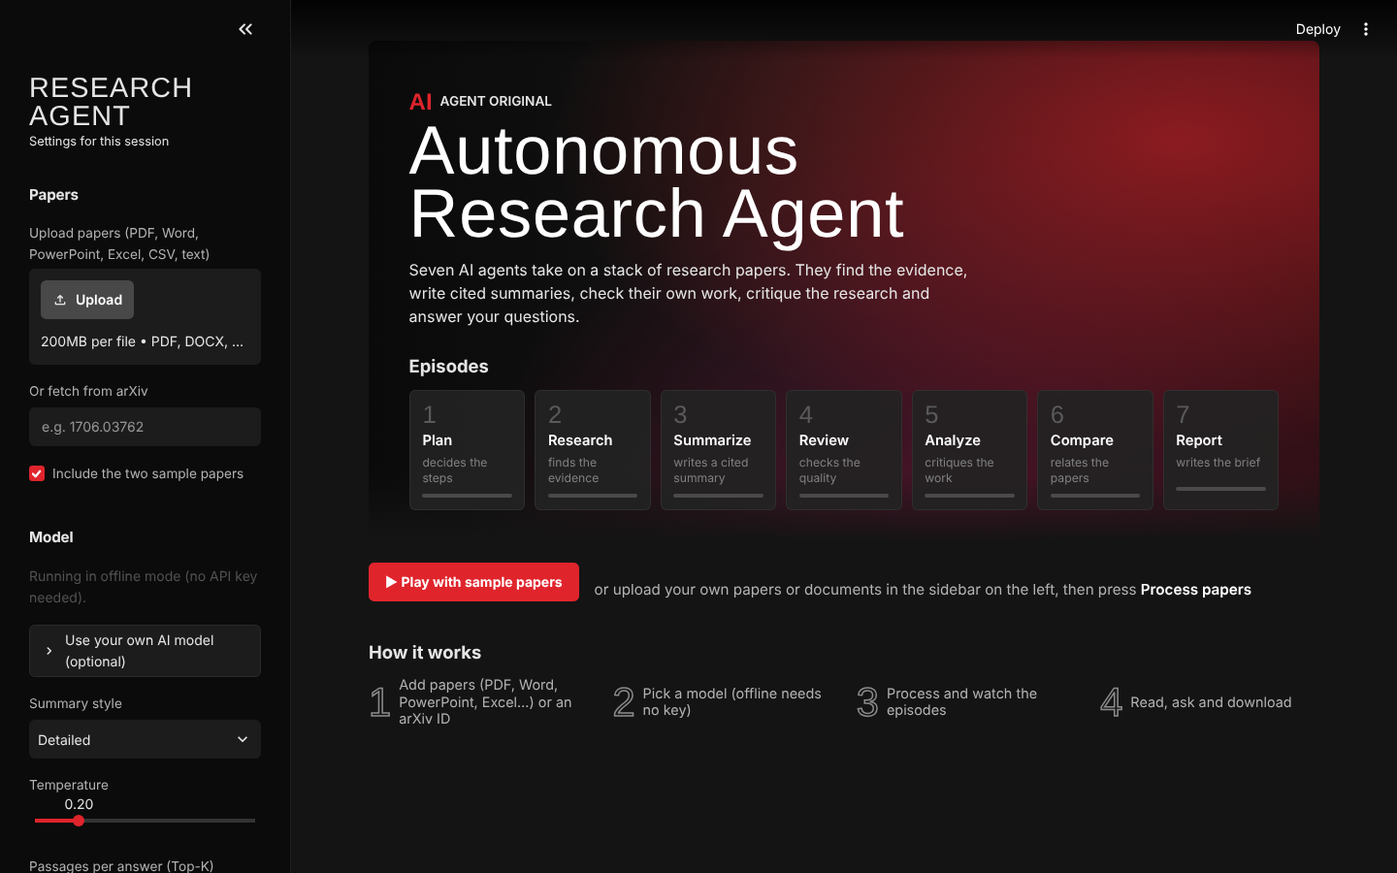
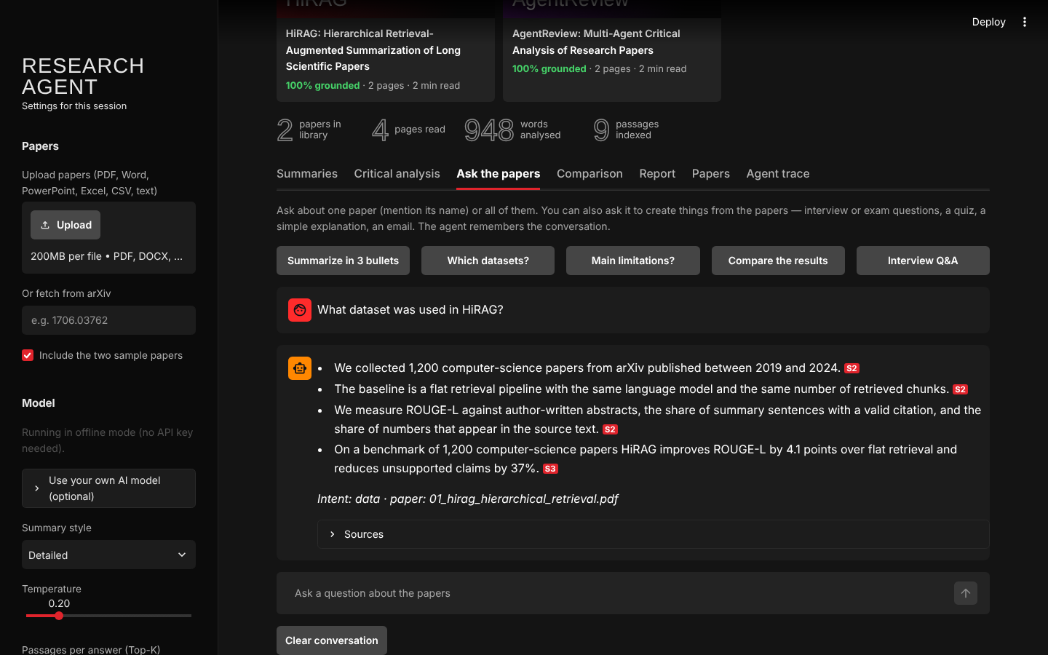
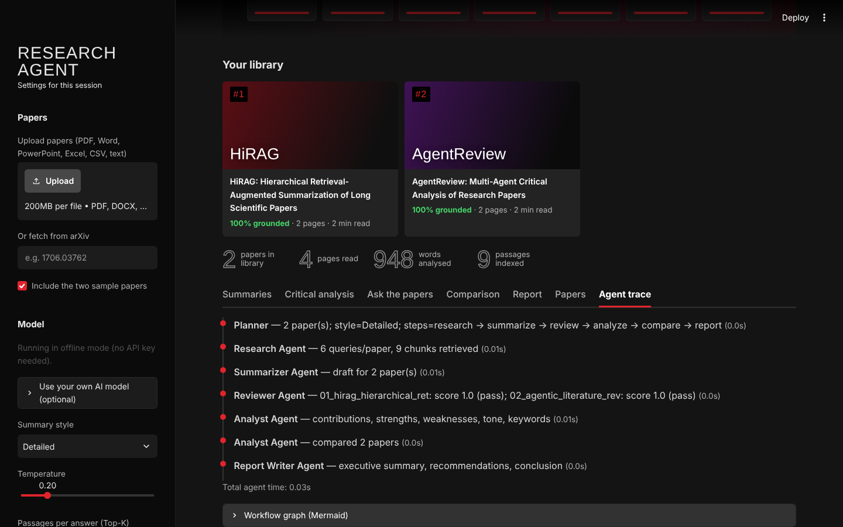
Demo: the running application
Home — seven agents as episodes
Cited summary + Reviewer scores
Chat — intent and paper detected
Agent trace with timings
Live demo script (≈ 3 min)
Click ▶ Play with sample papers and watch the 7 episode cards fill in
Summaries tab: point at a red [S2] tag, open Sources behind this summary
Ask the papers: “What dataset was used in HiRAG?” → intent data, paper HiRAG, cited answer
Report tab: download the PDF brief; Agent trace: show every step and its time
Notes:
These are real screenshots of the application, captured from a run on the two sample papers in offline mode.
Left to right: the home page, where the seven agents are shown as "episodes" that fill in as each one finishes; a cited summary with the Reviewer's coverage, grounding and faithfulness bars; the chat, which shows the detected intent and the paper the question was about; and the agent trace with timing for each step.
If time allows I'll run the live demo in the order shown at the bottom — it takes about three minutes.

Slide 9
Testing & evaluation
Test | What was checked | Result
End-to-end pipeline | 2 sample papers, both embedding back-ends: ingest → 7 agents → report | All steps complete; 4 pages, 948 words, 9 chunks
Metadata extraction | Title, authors, section headings for each paper | Correct for both papers; 7 sections each
Hallucination guard | Summary tampered with a fake figure (99.9%) and a fake tag [S9] | Score 0.923 but FAILED — both issues reported
Reflection loop | Impossible threshold (1.01), max 2 revisions | Exactly 2 revisions, then continued — no infinite loop
Chat routing | 5 questions: data, limitations, comparison, authors, create | 5 / 5 correct intent; paper detected when named
Export | PDF, DOCX and Markdown generation | All 3 generated (≈17 KB, 40 KB, 16 KB)
Resilience | Embedding model download blocked | Automatic fallback to HashingEmbeddings; run completed
Deployment | streamlit run + health check; UI driven by a headless browser | App healthy; screenshots captured from the live UI
Notes:
I tested the system at three levels.
Functional: a full end-to-end run on two sample papers with both embedding back-ends, checking every agent step, metadata extraction and all three export formats.
Negative tests, which I think matter most. I tampered with a summary — inserted a fabricated 99.9 percent and a fake citation tag. The weighted score was still 0.923, above threshold, but the hard rule on unsupported numbers failed it, and both problems were reported. I also forced an impossible threshold to prove the reflection loop stops after the configured number of revisions.
Deployment: I launched the Streamlit app, checked its health endpoint, and drove the UI with a headless browser — that's where the screenshots come from. In that environment the embedding model download was blocked, and the app fell back automatically and still completed.

Slide 10
Results
7 / 7
agent steps completed
1.00
Reviewer score, both papers
5 / 5
chat questions routed correctly
3
report formats exported
Offline scores are high by design (sentences are copied with their tags). The real proof is the tamper test: the guard fails a summary that the weighted score alone would pass.
Notes:
The headline numbers: all seven agent steps completed; the Reviewer scored both papers 1.00; five out of five chat questions were routed to the right intent and paper; and the report exported in three formats.
I want to be upfront about the 1.00. In offline mode the summarizer copies source sentences with their tags, so grounding and faithfulness are high almost by construction. The more convincing result is the chart: the clean summary versus the tampered one. Grounding drops to 0.88, faithfulness to 0.86, and the overall score is 0.92 — which would pass on the weighted score alone. The hard rule on unsupported numbers is what correctly fails it.
With a cloud LLM the scores genuinely vary, which is exactly when this check earns its place.

Slide 11
Challenges encountered and how I solved them
Retrieval missed whole sections
→
Section metadata on every chunk + one anchor chunk per canonical section before MMR
Messy PDF text
→
Headings glued to sentences, hyphenated line breaks, author lines in the abstract — handled with targeted regexes and sentence filters
A useful offline mode
→
Custom chat model: cue words + section match; headings with the fewest candidate sentences choose first
Providers retire models
→
Ask the provider which models the key can use; no retries on 401/404; clear guidance in the UI
Streamlit reruns the script
→
State in st.session_state, handlers attached once, class checks by name, cached model lists
Notes:
Five challenges stood out.
Retrieval kept missing whole sections — especially limitations — so I added section metadata and anchor chunks.
PDF extraction is messy: headings glued onto the first sentence, hyphenated line breaks, author names merged into the abstract. Each needed specific handling.
Making offline mode useful was the hardest. Early versions put a results sentence under Limitations because it had a number in it. The fix was to score by section and let headings with the fewest candidates pick first.
Model names keep changing, so the app asks the provider which models a key can use and doesn't waste retries on errors that retrying can't fix.
And Streamlit re-runs the whole script on every click, which caused several subtle bugs until state was managed properly.

Slide 12






Future enhancements
Claim-level verification
Labelled benchmark
Hybrid search + re-ranking
Match numbers with units and context; NLI entailment per bullet. Today “12” is found inside “1,200”.
20–30 real arXiv papers with questions; track Recall@k, MRR and RAGAS faithfulness.
BM25 + dense vectors and a cross-encoder for exact terms like dataset names.
Tables, figures, OCR
Parallel agents
Production deployment
Parse result tables and scanned PDFs so numbers can be compared across papers.
Per-paper research and summaries in parallel (LangGraph Send / async).
Docker, CI tests, persistent user libraries, DOCX/Markdown download buttons.
Notes:
The top priority comes straight from my own testing: the faithfulness check is a substring match, so a fabricated "12" passes because "1,200" contains it. Claim-level verification with units and an entailment model fixes that.
Second, a labelled benchmark on real papers, so design choices are measured, not eyeballed.
Then hybrid search with re-ranking, support for tables, figures and scanned PDFs, parallel agents for speed, and a production deployment with Docker, CI and persistent user libraries.

Slide 13
Key learnings
1
Retrieval quality decides answer quality
Most bad answers traced back to the wrong chunks, not the model. Section metadata was the biggest single improvement.
2
Verify with rules where you can
A deterministic Reviewer is cheap, reproducible and can't be talked round — but it must be tested with deliberately bad input.
3
Design for failure
Offline mode, fallbacks and clear errors made the app usable in a locked-down environment where the model download failed.
The agent trace: every step, its agent and its time — the audit trail behind “auditable”.
4
Agents make systems auditable
Splitting the work into agents with a trace shows exactly which step went wrong and how long each took.
Notes:
Four lessons.
One: retrieval decides answer quality. When an answer was wrong, it was nearly always because the wrong chunks were retrieved.
Two: where a rule can verify something, use a rule — but test it with deliberately broken input, which is how I found the substring weakness.
Three: design for failure. The fallback I built "just in case" is the reason the app worked in a test environment where the model download was blocked.
Four: agents aren't just a trend — they make a system auditable. The trace shows which step did what and how long it took.

Slide 14
CONCLUSION
Cited, self-checking research summaries — on any laptop
Complete
7 file types + arXiv in; summary, analysis, comparison, chat and report out
Trustworthy
every bullet cited; a Reviewer rejects unsupported numbers
Practical
4 model back-ends incl. offline; caching, fallbacks, clear errors
Honest
known gaps measured and documented, with a concrete roadmap
Notes:
To conclude: the project delivers cited, self-checking research summaries that run on any laptop.
It's complete — seven file types and arXiv in; summaries, analysis, comparison, chat and a report out. It's trustworthy — every bullet is cited and a Reviewer rejects unsupported numbers. It's practical — four model back-ends including offline, with caching, fallbacks and clear errors. And it's honest — I've measured and documented where it falls short and what I'd do next.

Slide 15

Questions?
Thank you
Akshay Kale · akshaykale3@gmail.com
Run it: streamlit run app.py → ▶ Play with sample papers
Notes:
Thank you. I'm happy to take questions — on the agent design, the Reviewer metrics, retrieval, the offline model, or anything else. If it helps, I can also run the demo live: streamlit run app.py and press Play with sample papers.

